Slide 1
錫膏色彩空間檢測
20241230
20250106
20250109
20250113
20250120
Joy Teng

Slide 2
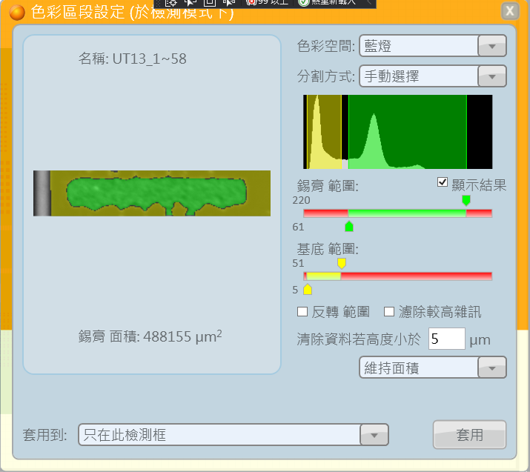
主程式位置
規格 -> 演算法 -> 一般 -> 色彩空間 -> 色彩檢測

Slide 3
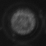
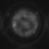
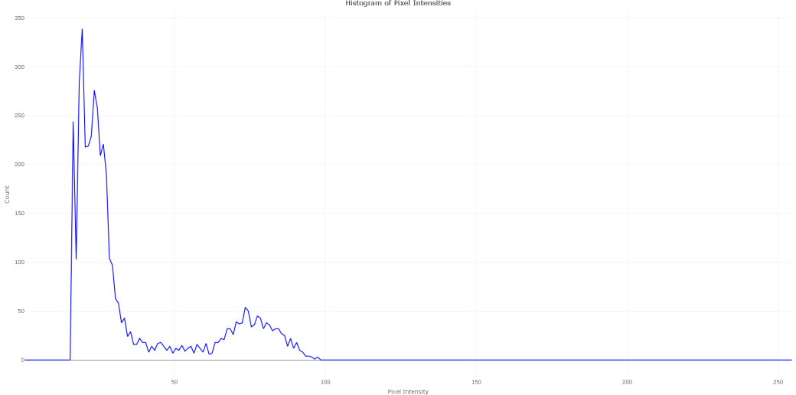
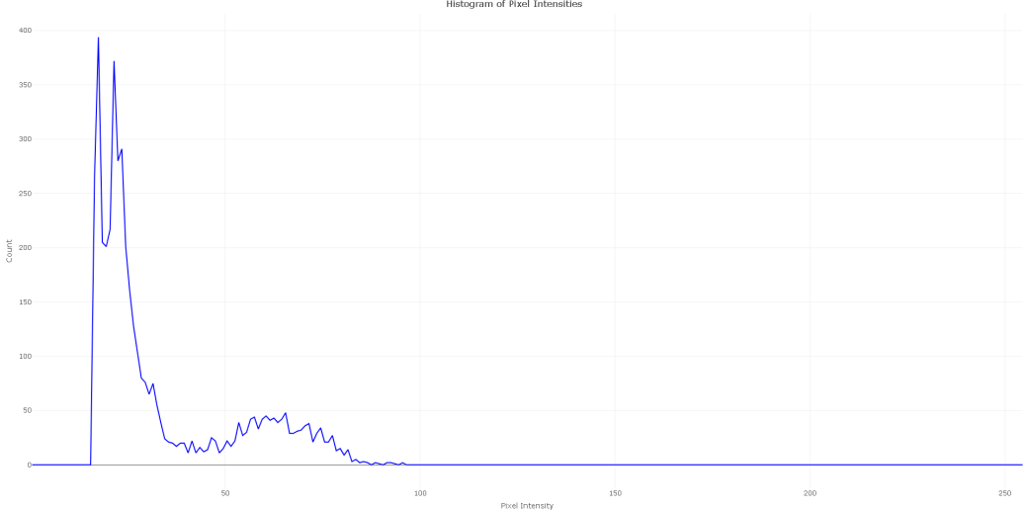
12/30 問題定義
不同錫膏影像，設定的門檻值可能會不同
目前方法手動設定門檻值(55, 100)，數值設定無特定依據
UT1_1~139_B
UT1_1~140_B

Slide 4
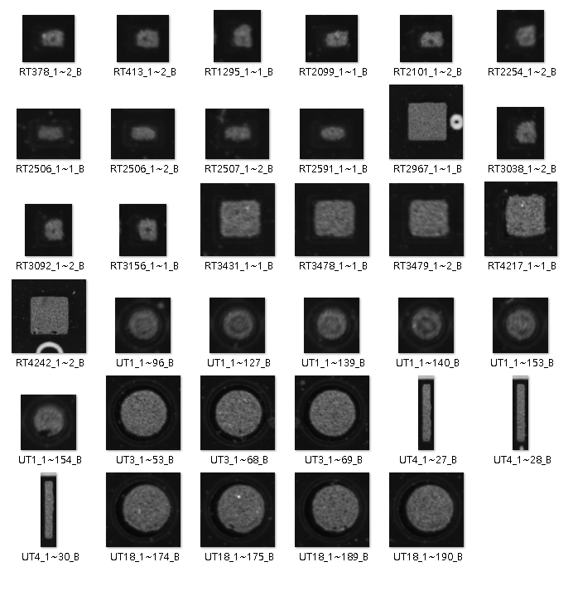
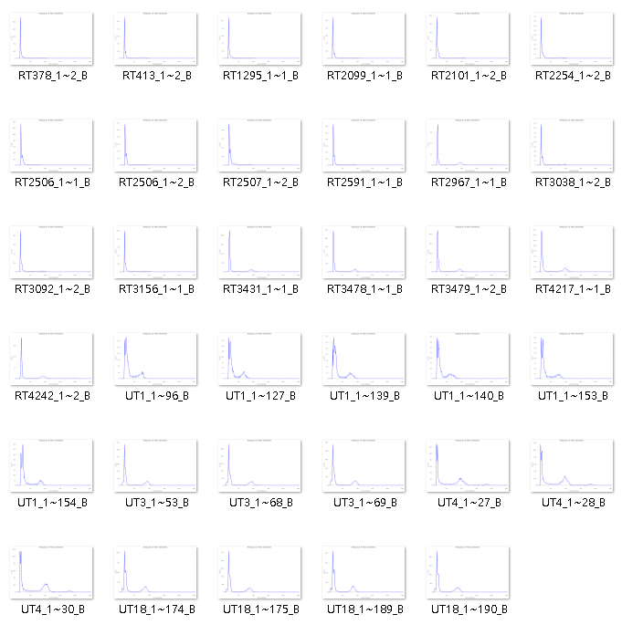
Small Dataset (35張錫膏影像)
B燈下錫膏影像
錫膏影像直方圖

Slide 5
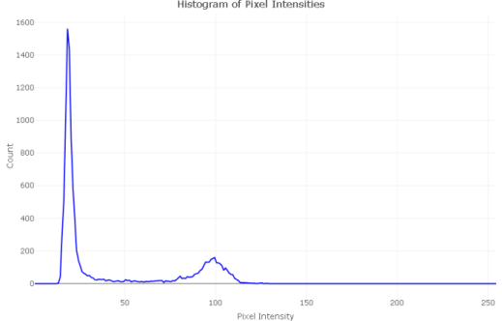
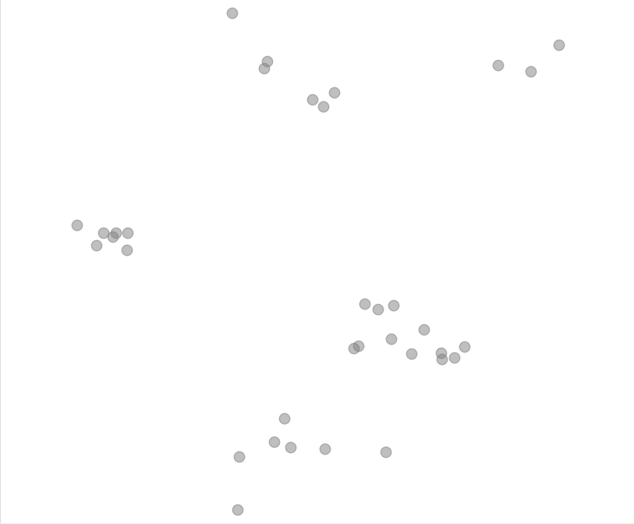
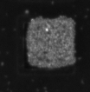
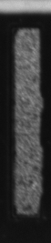
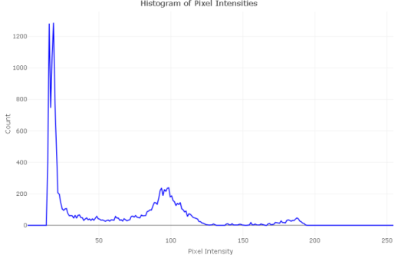
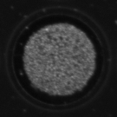
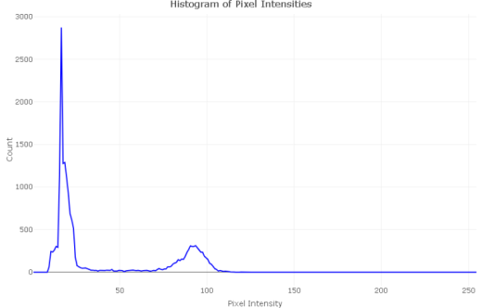
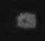
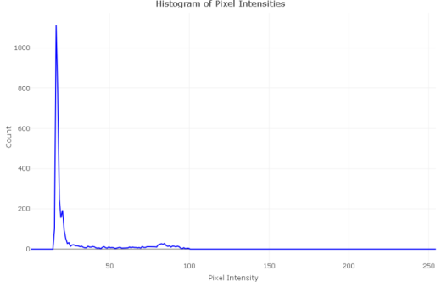
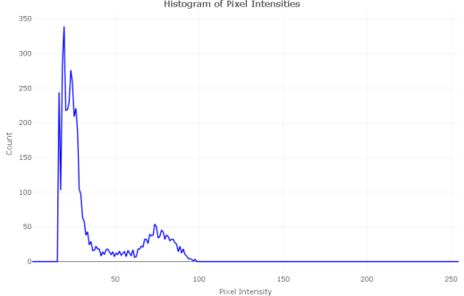
35張B燈下的錫膏影像
推測可能用做判斷的指標
y座標峰值高度
Pixel分布

Slide 6
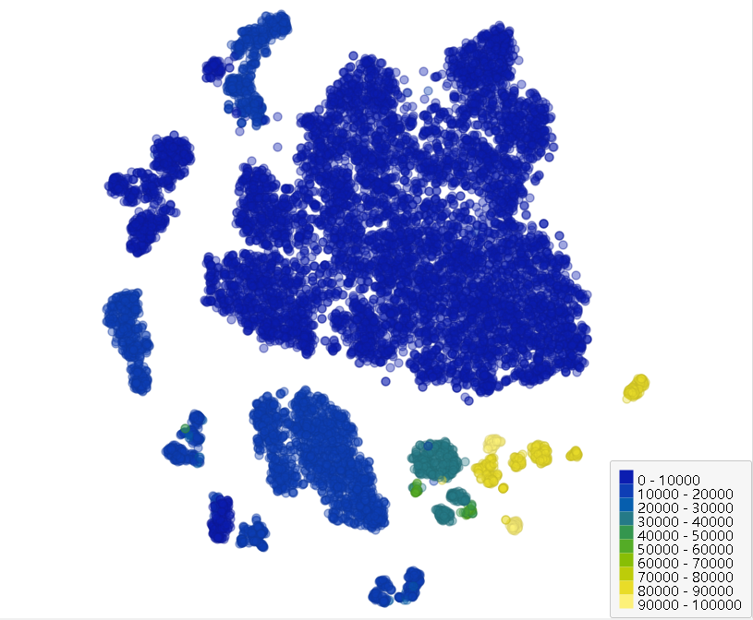
整板資料 (12978張錫膏影像)
幾個分析重點:
t-SNE model fine-tune
影像Size作為分群指標
觀察分群規律
紀錄權重&生成文件
流程自動化&功能上線

Slide 7
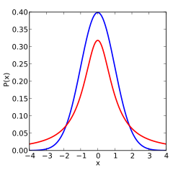
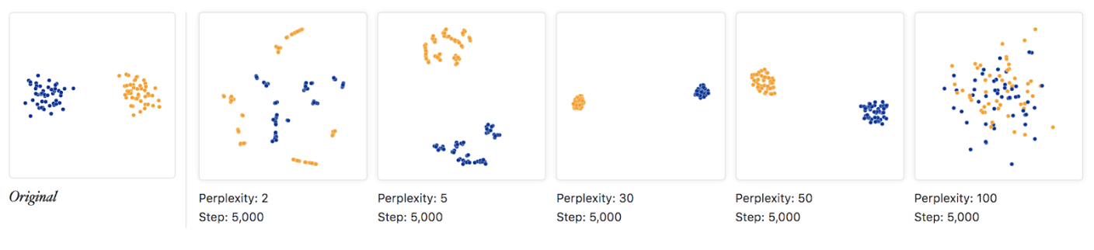
t-distributed Stochastic Neighbor Embedding (t-SNE)
t-隨機鄰近嵌入法
非線性的機器學習降維方法，跟PCA和K-Means各自有適合的應用場景
計算高維度樣本點之間的歐式距離，轉換為相似度機率
在低維度同樣建立一個機率模型，讓高維度映射到低維度
高維度採用高斯分布，低維度採用t分布 (1. 分布廣 2. 適用少樣本)
參數設置:
困惑度（perplexity）Main!!!
放大係數（exaggeration factor）
學習率（learning rate）
迭代次數（iterations）
t-SNE plots for five different perplexity values

Slide 8
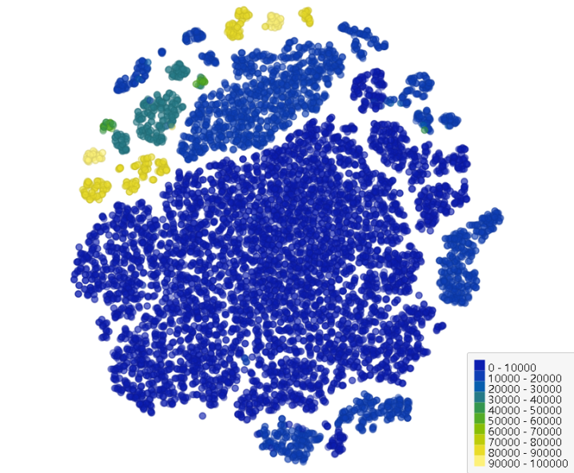
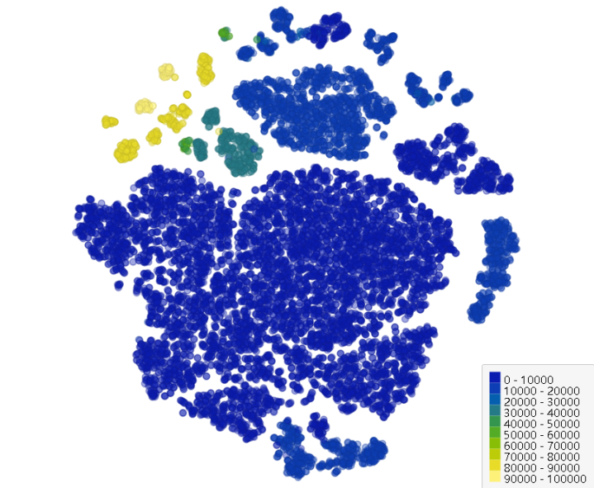
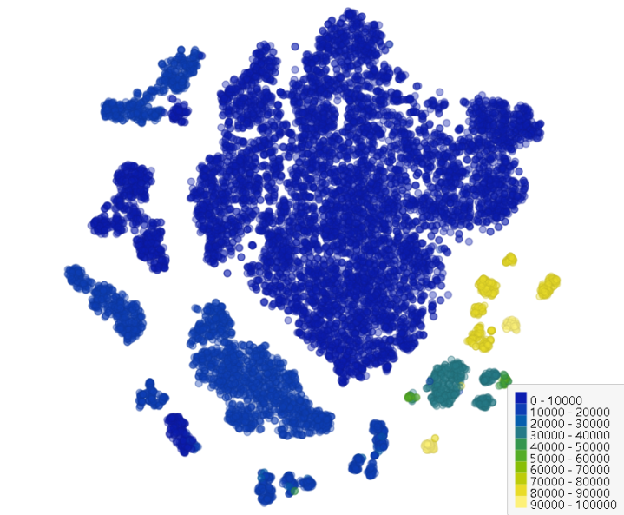

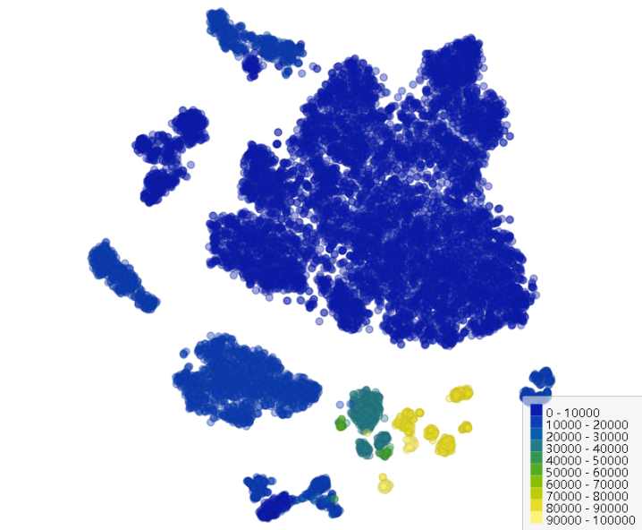
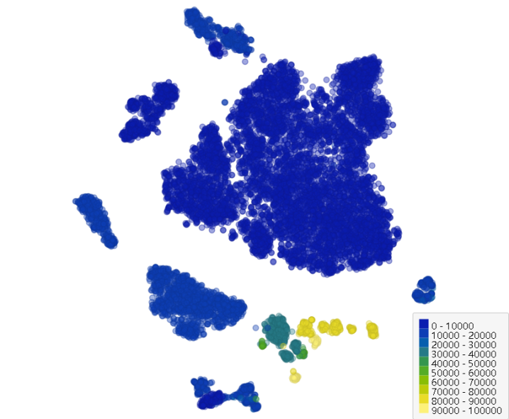
1. t-SNE model fine-tune (perplexity)
Perplexity = 5
Perplexity = 10
Perplexity = 20
Perplexity = 30
Perplexity = 40
Perplexity = 50

Slide 9
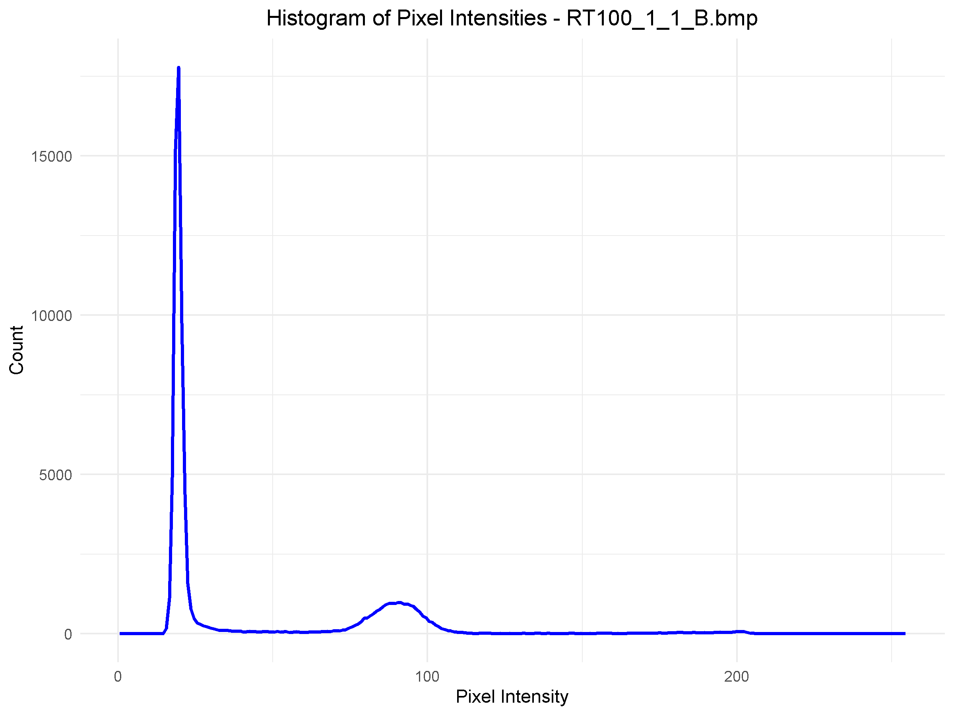
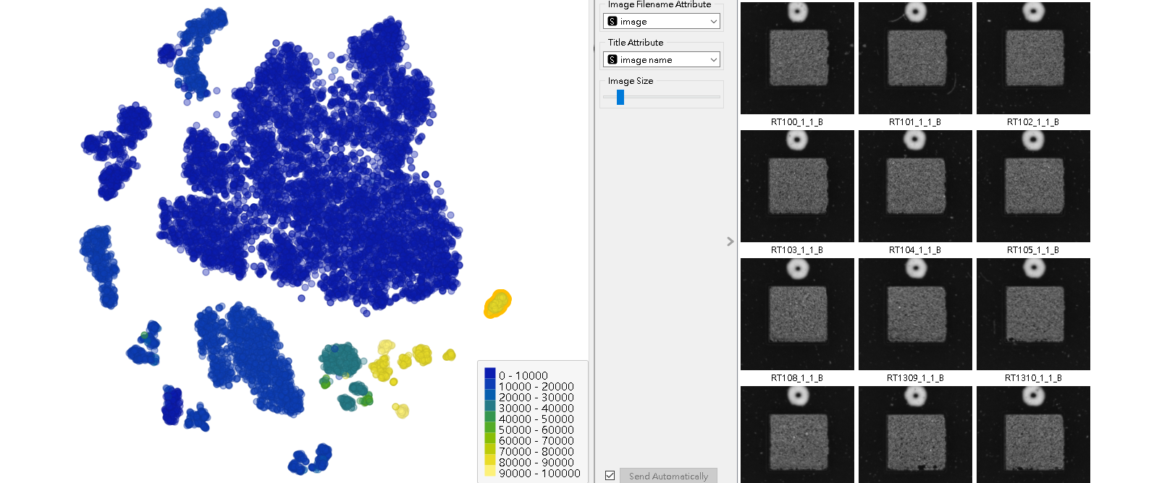
2. 影像Size作為分群指標

Slide 10
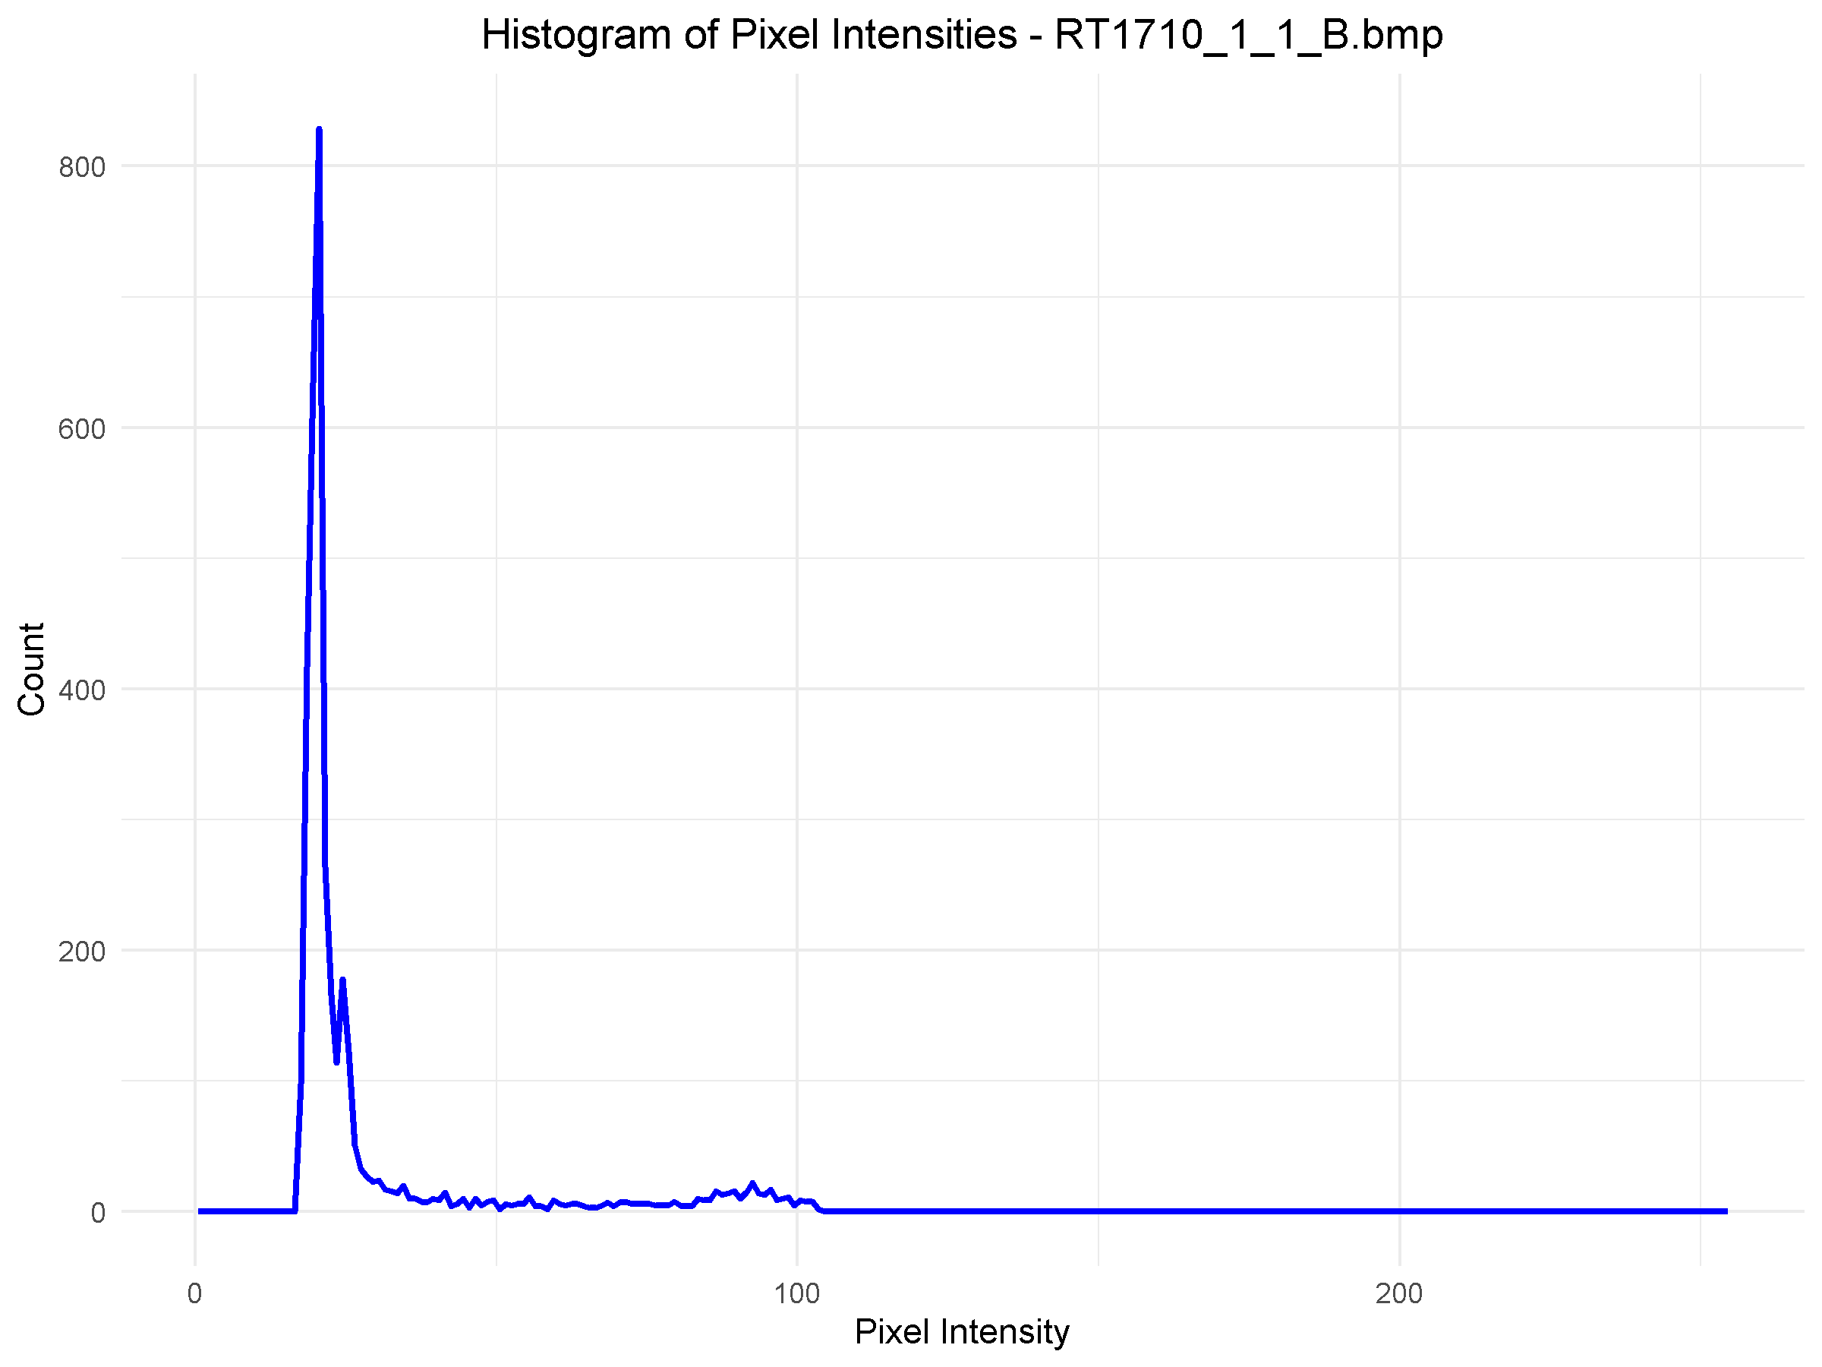
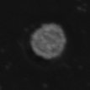
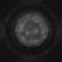
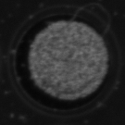
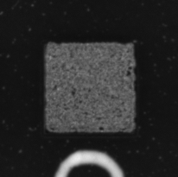
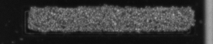
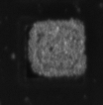
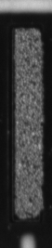
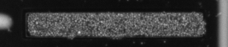
3. 觀察分群規律

Slide 11
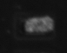
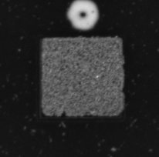
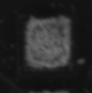
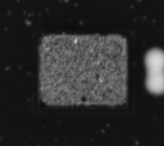
01/06 觀察分群規律 – RA, RT

Slide 12

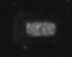
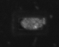
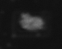
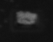
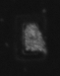
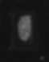
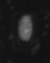
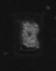
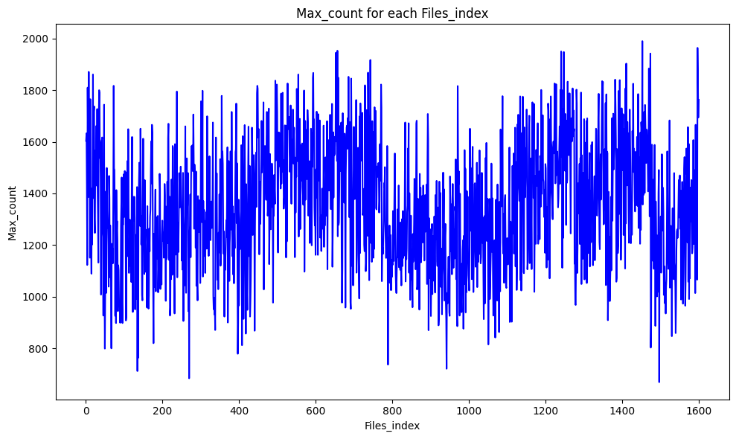
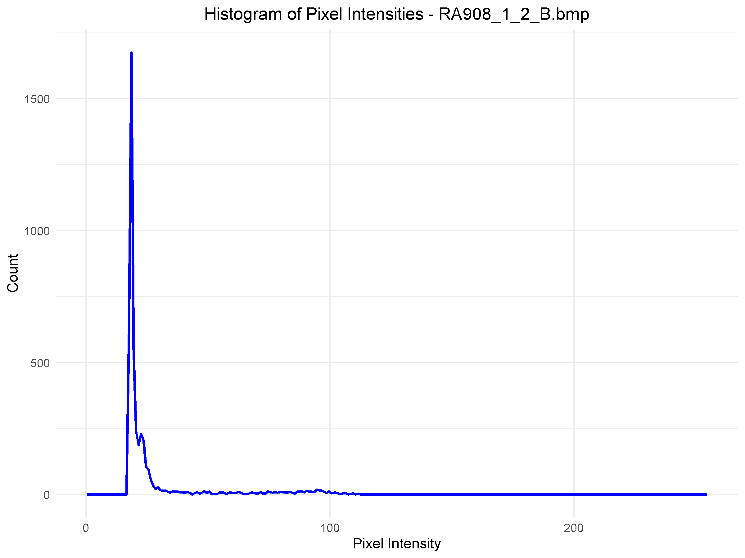
3. RA1 - RA984
共計1600張錫膏影像(20.4mm*16.1mm)
最大Count值是1990, RA90_1_1_B.csv
最小Count值是669, RA940_1_1_B.csv

Slide 13










3. RT1 - RT99
共計6706張錫膏影像(20.4mm*16.1mm)
最大Count值1834, RT661_1_1_B.csv
最小Count值307, RT1402_1_1_B.csv

Slide 14



3. RT100 - RT108
共計458張錫膏影像(75.7mm*76.5mm)
最大Count值20555, RT103_1_1_B.csv
最小Count值11608, RT785_1_1_B.csv

Slide 15




3. RT131 - RT134
共計360張錫膏影像(48.7mm*43.4mm)
最大Count值8860, RT1086_1_1_B.csv
最小Count值4095, RT4005_1_1_B.csv

Slide 16








3. RT1798 - RT1819
共計1410張錫膏影像(28.1mm*27.5mm)
最大Count值2938, RT3000_1_1_B.csv
最小Count值1172, RT4411_1_2_B.csv

Slide 17


4. 紀錄權重&生成文件
B: 藍燈下整板錫膏影像
B_csv: 紀錄錫膏像素密度和數量，用於後續門檻值計算
B_histogram: R語言生成的錫膏影像直方圖

Slide 18
01/09 觀察分群規律 – UT

Slide 19








3. UT1_9_14_15
UT1
UT9
UT14
UT15
共計381張錫膏影像(20.4mm*16.1mm)
最大Count值是538, UT1_1_188_B.csv
最小Count值是196, UT9_1_22_B.csv

Slide 20



UT1
UT14
UT9
UT15

Slide 21










3. UT2_3_7_8_10_11_12_18_19_20
UT2
UT3
UT7
UT8
UT10
UT11
UT12
UT18
UT19
UT20

Slide 22

3. UT2_3_7_8_10_11_12_18_19_20

Slide 23
3. UT2_3_7_8_10_11_12_18_19_20
UT10
UT2
UT11
UT3
UT8
UT18
UT12
UT19
UT20
UT7

Slide 24




3. UT2_3_7_8_10_11_12_18_19_20
UT2
UT7
UT3
UT8

Slide 25






3. UT2_3_7_8_10_11_12_18_19_20
UT10
UT12
UT19
UT11
UT18
UT20

Slide 26






3. UT4_5_6_13_16_17 (白線)
UT4
UT5
UT6
UT13
UT17
UT16

Slide 27





3. UT4_5_6_13_16_17 (白線)
UT4
UT17
UT13, UT16
UT5, UT6

Slide 28






3. UT4_5_6_13_16_17 (白線)
UT4
UT5
UT6
UT13
UT16
UT17

Slide 29

01/13

Slide 30



Slide 31



Laplacian variance
Pech-Pacheco, José Luis, et al. "Diatom autofocusing in brightfield microscopy: a comparative study." Proceedings 15th International Conference on Pattern Recognition. ICPR-2000. Vol. 3. IEEE, 2000.

Slide 32


Piecewise Linear Regression (PLR)
將255個灰階值透過少數特徵點表示
設定動態門檻值可採用第四個點和第五個點之間的距離

Slide 33














01/20 Laplacian Variance
UT1_1~127_B.bmp | 40.80752907
UT1_1~139_B.bmp | 46.57544114
UT1_1~140_B.bmp | 41.9719028
UT1_1~153_B.bmp | 40.1794992
UT1_1~154_B.bmp | 42.08576396
UT1_1~96_B.bmp | 39.59588839
UT3_1~53_B.bmp | 136.5496208
UT3_1~68_B.bmp | 149.4205286
UT3_1~69_B.bmp | 115.8616735
UT4_1~27_B.bmp | 124.7749244
UT4_1~28_B.bmp | 118.4955775
UT4_1~30_B.bmp | 119.5499872
UT18_1~174_B.bmp | 59.74505984
UT18_1~175_B.bmp | 61.07117156
UT18_1~189_B.bmp | 60.62867458
UT18_1~190_B.bmp | 58.37905888

Slide 34

















Laplacian Variance
RT1295_1~1_B.bmp | 33.74383
RT2254_1~2_B.bmp | 29.52807
RT2506_1~1_B.bmp | 22.85437
RT2506_1~2_B.bmp | 23.64182
RT2507_1~2_B.bmp | 25.64356
RT2591_1~1_B.bmp | 22.21281
RT378_1~2_B.bmp | 31.02932
RT413_1~2_B.bmp | 28.99006
RT4217_1~1_B.bmp | 185.3008676
RT4242_1~2_B.bmp | 222.551169
RT2099_1~1_B.bmp | 51.975
RT2101_1~2_B.bmp | 55.46115
RT2967_1~1_B.bmp | 68.66664
RT3038_1~2_B.bmp | 44.64998
RT3092_1~2_B.bmp | 41.94497
RT3156_1~1_B.bmp | 54.6208
RT3431_1~1_B.bmp | 59.45811
RT3478_1~1_B.bmp | 55.35222
RT3479_1~2_B.bmp | 51.50992

Slide 35






K-Means

Slide 36


驗證Size無法作為判斷依據
1D K-Means分群表現優於2D K-Means
1D: Laplacian Variance
2D: Laplacian Variance & Image Size

Slide 37
K-Means門檻值(K=5)
K-Means boundaries
K-Means Centroids
Cluster 0: Min Laplacian Variance = 18.70, Max Laplacian Variance = 70.51
Cluster 1: Min Laplacian Variance = 70.52, Max Laplacian Variance = 161.01
Cluster 2: Min Laplacian Variance = 161.06, Max Laplacian Variance = 320.50
Cluster 3: Min Laplacian Variance = 322.27, Max Laplacian Variance = 624.93
Cluster 4: Min Laplacian Variance = 680.45, Max Laplacian Variance = 1034.04
Cluster 0: Centroids = 38.55
Cluster 1: Centroids = 102.47
Cluster 2: Centroids = 219.63
Cluster 3: Centroids = 422.04
Cluster 4: Centroids = 867.58

Slide 38
K-Means門檻值如何設定?
以12978張的影像資料集為例，約7-8千張影像的 Laplacian Variance 數值在70以下，模糊影像錫膏灰階峰值在75左右
Laplacian Variance 數值在70以上的清晰影像錫膏灰階峰值在90左右，約4-5千張影像
持續進行K-Means分類，計算Cluster 0的最小誤差
Cluster 0 以上為清晰影像，noise 相對較少，門檻值好設定

Slide 39

2D Tuning 平均值&標準差

Slide 40

2D Tuning (square)
Cluster 0: Min Laplacian Variance = 18.70, Max Laplacian Variance = 126.23 Cluster 1: Min Laplacian Variance = 126.51, Max Laplacian Variance = 540.55
K-means Cluster Centers (Laplacian Variance): [[ 48.2] [204.47]]

Slide 41

2D Tuning (square)
Cluster 2: Min Laplacian Variance = 18.7, Max Laplacian Variance = 75.43 Cluster 0: Min Laplacian Variance = 75.5, Max Laplacian Variance = 191.35 Cluster 1: Min Laplacian Variance = 191.54, Max Laplacian Variance = 540.55
K-means Cluster Centers (Laplacian Variance): [[112.1 ] [270.65] [ 38.87]]

Slide 42

2D Tuning (square)
Cluster 2: Min Laplacian Variance = 18.7, Max Laplacian Variance = 63.43 Cluster 0: Min Laplacian Variance = 63.47, Max Laplacian Variance = 135.4 Cluster 3: Min Laplacian Variance = 135.6, Max Laplacian Variance = 255.43 Cluster 1: Min Laplacian Variance = 256.03, Max Laplacian Variance = 540.55
K-means Cluster Centers (Laplacian Variance): [[ 90.73] [331.82] [ 36.19] [180.23]]

Slide 43

2D Tuning (square)
Cluster 4: Min Laplacian Variance = 49.96, Max Laplacian Variance = 93.16 Cluster 2: Min Laplacian Variance = 18.7, Max Laplacian Variance = 49.92 Cluster 3: Min Laplacian Variance = 164.75, Max Laplacian Variance = 287.54 Cluster 0: Min Laplacian Variance = 93.18, Max Laplacian Variance = 164.09 Cluster 1: Min Laplacian Variance = 288.68, Max Laplacian Variance = 540.55
K-means Cluster Centers (Laplacian Variance): [[118.98] [366.62] [ 32.53] [210.08] [ 67.38]]

Slide 44

2D Tuning (rect)
Cluster 0: Min Laplacian Variance = 52.15, Max Laplacian Variance = 356.74 Cluster 1: Min Laplacian Variance = 360.9, Max Laplacian Variance = 1034.04
K-means Cluster Centers (Laplacian Variance): [[151.06] [562.58]]
最小值52.15 -> rect 全部屬於清晰影像

Slide 45

2D Tuning (rect)
Cluster 0: Min Laplacian Variance = 52.15, Max Laplacian Variance = 276.09 Cluster 2: Min Laplacian Variance = 276.6, Max Laplacian Variance = 624.93 Cluster 1: Min Laplacian Variance = 680.45, Max Laplacian Variance = 1034.04
K-means Cluster Centers (Laplacian Variance): [[134.19] [867.58] [418.99]]

Slide 46

2D Tuning (rect)
Cluster 0: Min Laplacian Variance = 52.15, Max Laplacian Variance = 204.34 Cluster 2: Min Laplacian Variance = 205.27, Max Laplacian Variance = 390.77 Cluster 1: Min Laplacian Variance = 394.76, Max Laplacian Variance = 680.45 Cluster 3: Min Laplacian Variance = 697.4, Max Laplacian Variance = 1034.04
K-means Cluster Centers (Laplacian Variance): [[120.38] [495.12] [288.45] [873.42]]

Slide 47

2D Tuning (rect)
Cluster 0: Min Laplacian Variance = 52.15, Max Laplacian Variance = 167.92 Cluster 4: Min Laplacian Variance = 168.81, Max Laplacian Variance = 305.67 Cluster 2: Min Laplacian Variance = 307.93, Max Laplacian Variance = 468.09 Cluster 1: Min Laplacian Variance = 476.28, Max Laplacian Variance = 712.11 Cluster 3: Min Laplacian Variance = 728.84, Max Laplacian Variance = 1034.04
K-means Cluster Centers (Laplacian Variance): [[110.35] [550.73] [388. ] [897.14] [226.44]]

Slide 48

2D Tuning (circle)
Cluster 0: Min Laplacian Variance = 23.09, Max Laplacian Variance = 179.48 Cluster 1: Min Laplacian Variance = 180.34, Max Laplacian Variance = 548.88
K-means Cluster Centers (Laplacian Variance): [[ 61.56] [297.63]]
小又模糊的影像才會有錫膏影像左移問題

Slide 49

2D Tuning (circle)
Cluster 0: Min Laplacian Variance = 23.09, Max Laplacian Variance = 106.14 Cluster 2: Min Laplacian Variance = 106.84, Max Laplacian Variance = 248.64 Cluster 1: Min Laplacian Variance = 251.78, Max Laplacian Variance = 548.88
K-means Cluster Centers (Laplacian Variance): [[ 52.02] [341.83] [161.52]]

Slide 50

2D Tuning (circle)
Cluster 0: Min Laplacian Variance = 23.09, Max Laplacian Variance = 80.95 Cluster 2: Min Laplacian Variance = 81.05, Max Laplacian Variance = 181.34 Cluster 1: Min Laplacian Variance = 184.52, Max Laplacian Variance = 323.2 Cluster 3: Min Laplacian Variance = 326.89, Max Laplacian Variance = 548.88
K-means Cluster Centers (Laplacian Variance): [[ 46.47] [249.95] [115.62] [403.58]]

Slide 51

2D Tuning (circle)
Cluster 0: Min Laplacian Variance = 23.09, Max Laplacian Variance = 63.87 Cluster 2: Min Laplacian Variance = 63.97, Max Laplacian Variance = 125.57 Cluster 1: Min Laplacian Variance = 220.17, Max Laplacian Variance = 343.4 Cluster 4: Min Laplacian Variance = 127.05, Max Laplacian Variance = 219.53 Cluster 3: Min Laplacian Variance = 346.27, Max Laplacian Variance = 548.88
K-means Cluster Centers (Laplacian Variance): [[ 41.23] [273.04] [ 86.54] [417.32] [166.41]]

Slide 52

PV值分析
由於波谷震盪，很難找到參考點or參考區間
第一個波峰的高度太高，且不是關鍵資訊
Base/Pad
Solder
Whiteline

Slide 53


PLR分析_手動設定

Slide 54

PLR分析_端點
Piecewise端點座標：
起點: (0.5, 0)
端點1: (31.5, 55)
端點2: (63.5, 50)
端點3: (95.5, 259)
端點4: (127.5, 0)
端點5: (158.5, 37)
端點6: (190.5, 1)
端點7: (222.5, 0)
終點: (254.5, 0)

Slide 55

AIC/BIC

Slide 56

PLR分析_AIC

Slide 57

PLR分析_BIC

